Slide 1
Logging
Fred

Slide 2
Fundamental
Static Layer
Write into file
Dynamic Layer
Print on the screen
Level
Crash : 1
Error : 2
Warning : 3
Notice : 4
Info : 5
Debug : 7
Trace : 8
Dump : 9

Slide 3
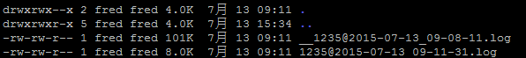
Fundamental(Cont.)
Rolling Files
The format of file name is {pid}@{date & time}.log
Old file would be renamed to __{original name}.

Slide 4
Functions
Local
AdvLog_Init()
AdvLog_Arg(int argc, char **argv)
AdvLog_Default(char *arg)
Remote
AdvLog_Control(int argc, char **argv)
Prints
ADV_INFO(fmt,...)
ADV_C_INFO(color,fmt,...)
…

Slide 5
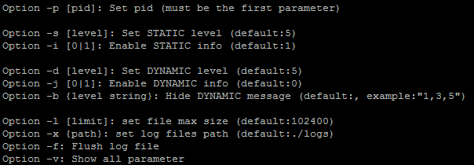
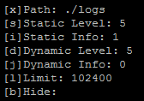
Remote comnand
Command list:
-v:

Slide 6
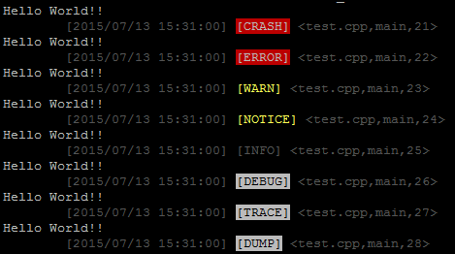
Information Header and Level Tag

Slide 7
Demo

